Slide 1


Slide 2
K-Means Clustering

Slide 3
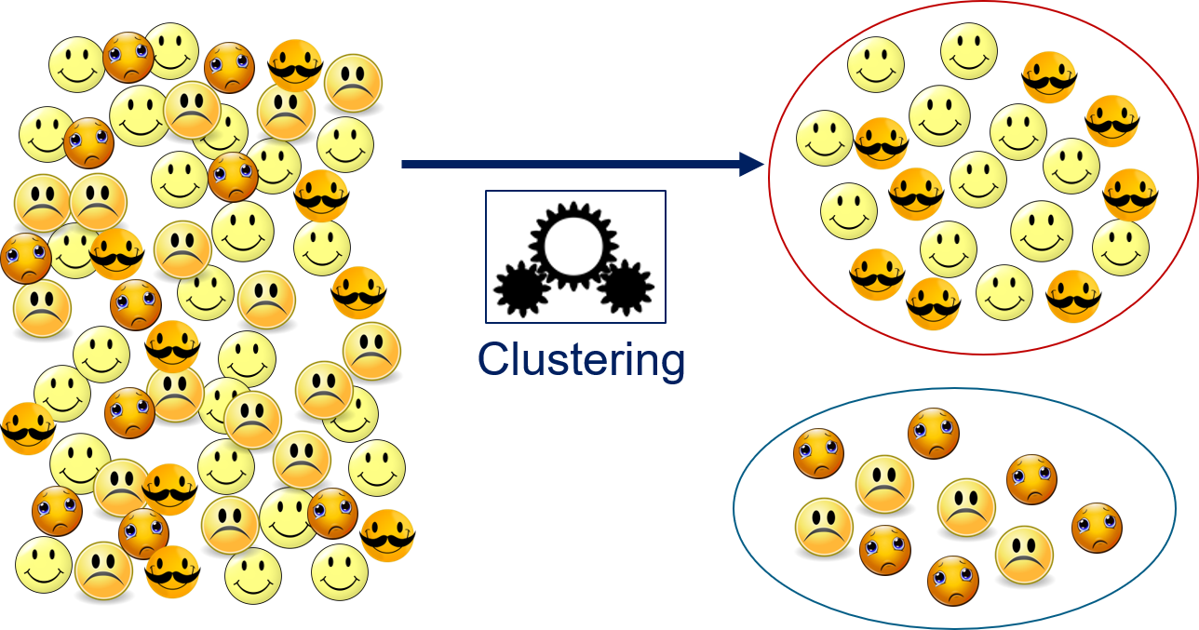
INTRODUCTION-
What is clustering?
Clustering is somewhat different from the classification, numeric prediction, and pattern detection tasks we examined.
cluster refers to a group of similar things or people that are positioned or occur closely together.

Slide 4
INTRODUCTION-
What is K-Means?
K-Means is an unsupervised machine learning algorithm used for clustering.
It aims to partition data points into k clusters based on their similarity.
The algorithm iteratively adjusts cluster centroids to minimize the inertia.

Slide 5

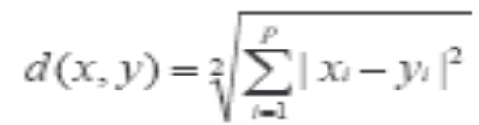
Common Distance measures:
Distance measure will determine how the similarity of two elements is calculated and it will influence the shape of the clusters.
They include:
1. The Manhattan distance (also called 2-norm distance) is given by:
2. The Euclidean distance
(also called taxicab norm or 1-norm) is given by:

Slide 6

^{K-Means}
An algorithm for partitioning (or clustering) N data points into K disjoint subsets S_{j} containing data points so as to minimize the sum-of-squares criterion
where x_{n} is a vector representing the the n^{th} data point and u_{j} is the geometric centroid of the data points in S_{j}.

Slide 7
^{K-Means}
Simply speaking k-means clustering is an algorithm to classify or to group the objects based on attributes/features into K number of group.
K is positive integer number.
The grouping is done by minimizing the sum of squares of distances between data and the corresponding cluster centroid.

Slide 8

How the K-Mean Clustering algorithm works?

Slide 9

A Simple example showing the implementation of k-means algorithm
(using K=2)

Slide 10


Step 1:
Initialization: Randomly we choose following two centroids (k=2) for two clusters.
In this case the 2 centroid are: m1=(1.0,1.0) and m2=(5.0,7.0).

Slide 11




Step 2:
Thus, we obtain two clusters containing:
{1,2,3} and {4,5,6,7}.
Their new centroids are:

Slide 12

Step 3:
Now using these centroids we compute the Euclidean distance of each object, as shown in table.
Therefore, the new clusters are:
{1,2} and {3,4,5,6,7}
Next centroids are: m1=(1.25,1.5) and m2 = (3.9,5.1)

Slide 13

Step 4 :
The clusters obtained are:
{1,2} and {3,4,5,6,7}
Therefore, there is no change in the cluster.
Thus, the algorithm comes to a halt here and final result consist of 2 clusters {1,2} and {3,4,5,6,7}.

Slide 14

PLOT

Slide 15
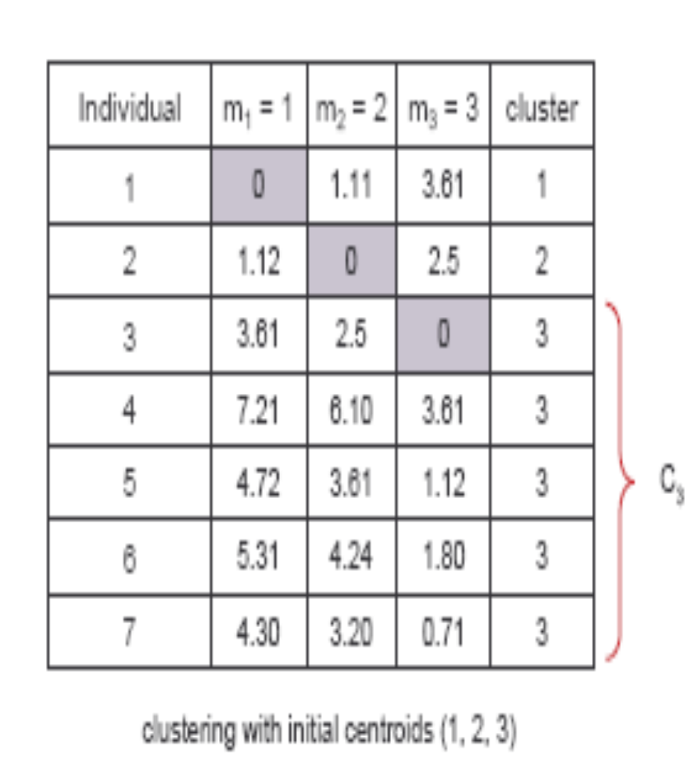
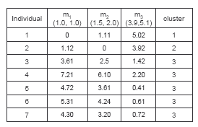
(with K=3)
Step 1
Step 2

Slide 16
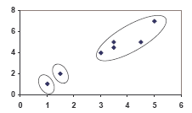
PLOT

Slide 17
Thank You

